Slide 1
APPLICATION OF GIS WITH PYTHON

Slide 2
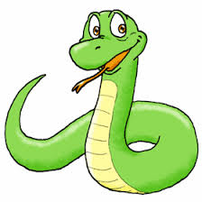

9. Working with images
https://pcjericks.github.io/py-gdalogr-cookbook/
https://www.python.org/

Slide 3
Raster Data
Driver: GTiff/GeoTIFF
Files: world.tif
Size is 2048, 1024
Coordinate System is:
GEOGCS["WGS 84",
DATUM["WGS_1984",
SPHEROID["WGS 84",6378137,298.257223563,
AUTHORITY["EPSG","7030"]],
AUTHORITY["EPSG","6326"]],
PRIMEM["Greenwich",0],
UNIT["degree",0.0174532925199433],
AUTHORITY["EPSG","4326"]]
Origin = (-180.000000000000000,90.000000000000000)
Pixel Size = (0.175781250000000,-0.175781250000000)
Metadata:
AREA_OR_POINT=Area
Image Structure Metadata:
INTERLEAVE=BAND
Corner Coordinates:
Upper Left (-180.0000000, 90.0000000) (180d 0' 0.00"W, 90d 0' 0.00"N)
Lower Left (-180.0000000, -90.0000000) (180d 0' 0.00"W, 90d 0' 0.00"S)
Upper Right ( 180.0000000, 90.0000000) (180d 0' 0.00"E, 90d 0' 0.00"N)
Lower Right ( 180.0000000, -90.0000000) (180d 0' 0.00"E, 90d 0' 0.00"S)
Center ( 0.0000000, 0.0000000) ( 0d 0' 0.01"E, 0d 0' 0.01"N)
Band 1 Block=256x256 Type=Byte, ColorInterp=Red
Overviews: 1024x512, 512x256, 256x128, 128x64, 64x32, 32x16, 16x8
Band 2 Block=256x256 Type=Byte, ColorInterp=Green
Overviews: 1024x512, 512x256, 256x128, 128x64, 64x32, 32x16, 16x8
Band 3 Block=256x256 Type=Byte, ColorInterp=Blue
Overviews: 1024x512, 512x256, 256x128, 128x64, 64x32, 32x16, 16x8

Slide 4
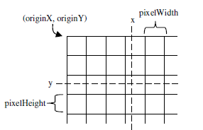
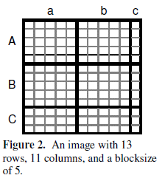
Raster Data

Slide 5
Reading raster data
Need to import two modules in order to work with raster
The gdal module does the hard work, but the gdalconst module includes the constants that are required for some things
import gdal
from gdalconst import *

Slide 6
Reading raster data
The supported image formats are described at http://www.gdal.org/formats_list.html and there is an associated driver for each one. Or type in command prompt
gdalinfo --formats
In case of GDAL get a driver before we open a file. And need to register a driver before use.
driver = gdal.GetDriverByName('HFA')
driver.Register()
*In osgeo distribution raster may open and read without driver

Slide 7
Reading raster data
from osgeo import gdal
import os
os.chdir("E:\\WRC\\ospy_data2")
ds = gdal.Open('aster.img')
print('File list:', ds.GetFileList())
print('Width:', ds.RasterXSize)
print('Height:', ds.RasterYSize)
print('Coordinate system:', ds.GetProjection())
gt = ds.GetGeoTransform() # captures origin and pixel size
print('Origin:', (gt[0], gt[3]))
print('Pixel size:', (gt[1], gt[5]))
print('Upper Left Corner:', gdal.ApplyGeoTransform(gt,0,0))
print('Upper Right Corner:', gdal.ApplyGeoTransform(gt,ds.RasterXSize,0))
print('Lower Left Corner:', gdal.ApplyGeoTransform(gt,0,ds.RasterYSize))
print('Lower Right Corner:',gdal.ApplyGeoTransform(gt,ds.RasterXSize,ds.RasterYSize))
print('Center:', gdal.ApplyGeoTransform(gt,ds.RasterXSize/2,ds.RasterYSize/2))
print('Metadata:', ds.GetMetadata())
print('Image Structure Metadata:', ds.GetMetadata('IMAGE_STRUCTURE'))
print('Number of bands:', ds.RasterCount)
for i in range(1, ds.RasterCount+1):
band = ds.GetRasterBand(i) # in GDAL, band are indexed starting at 1!
interp = band.GetColorInterpretation()
interp_name = gdal.GetColorInterpretationName(interp)
(w,h)=band.GetBlockSize()
print('Band %d, block size %dx%d, color interp %s' % (i,w,h,interp_name))
ovr_count = band.GetOverviewCount()
for j in range(ovr_count):
ovr_band = band.GetOverview(j) # but overview bands starting at 0
print(' Overview %d: %dx%d'%(j, ovr_band.XSize, ovr_band.YSize))

Slide 8
Reading raster data
import os, gdal
os.chdir(r'E:\WRC\2015winter\Gis With Python\labs\pyFiles\gggddaall')
#information about 288316a.tif
ds=gdal.Open('288316a/288316a.tif')
#Files : list of files. Main file + potential additional files
print('File list:', ds.GetFileList())
#raster width in pixels
print('Width:', ds.RasterXSize)
#raster height in pixels
print('Height:', ds.RasterYSize)
#spatial reference system in WKT format
print('Coordinate system:', ds.GetProjection())
gt = ds.GetGeoTransform() # captures origin and pixel size click here
#corner and centre coordinates
print('Origin:', (gt[0], gt[3]))
print('Pixel size:', (gt[1], gt[5]))
print('Upper Left Corner:', gdal.ApplyGeoTransform(gt,0,0))
print('Upper Right Corner:', gdal.ApplyGeoTransform(gt,ds.RasterXSize,0))
print('Lower Left Corner:', gdal.ApplyGeoTransform(gt,0,ds.RasterYSize))
print('Lower Right Corner:',gdal.ApplyGeoTransform(gt,ds.RasterXSize,ds.RasterYSize))
print('Center:', gdal.ApplyGeoTransform(gt,ds.RasterXSize/2,ds.RasterYSize/2))
#metadata of raster file, a list of KEY=VALUE pairs, depending on the format and data
print('Metadata:', ds.GetMetadata())
#like arrangement of pixels; INTERLEAVE=BAND:first all pixels for first band then others
print('Image Structure Metadata:', ds.GetMetadata('IMAGE_STRUCTURE'))
print('Number of bands:', ds.RasterCount)
#looping for each band
for i in range(1, ds.RasterCount+1):
band = ds.GetRasterBand(i) # in GDAL, band are indexed starting at 1!
interp = band.GetColorInterpretation()#display color
interp_name = gdal.GetColorInterpretationName(interp)
(w,h)=band.GetBlockSize()#block size:lines(col,row),square,tiles
print('Band %d, block size %dx%d, color interp %s' % (i,w,h,interp_name))
#reduced resolution size of full resolution
ovr_count = band.GetOverviewCount()
for j in range(ovr_count):
ovr_band = band.GetOverview(j) # but overview bands starting at 0
print(' Overview %d: %dx%d'%(j, ovr_band.XSize, ovr_band.YSize))

Slide 9
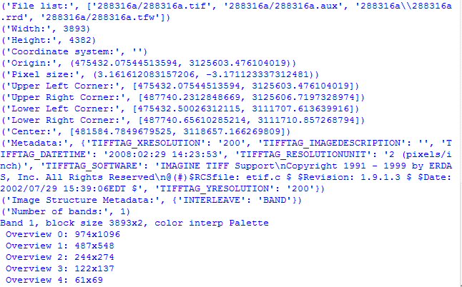
Reading raster data

Slide 10
Opening a raster data set
Once the driver has been registered, the Open(<filename>, <GDALAccess>) method can be used to return a Dataset object.
fn = 'aster.img'
ds = gdal.Open(fn, GA_ReadOnly)
if ds is None:
print 'Could not open ' + fn
sys.exit(1)

Slide 11
Getting image dimensions
Dataset objects have properties corresponding to numbers of rows, columns and bands in the data set
cols = ds.RasterXSize
rows = ds.RasterYSize
bands = ds.RasterCount
Notice no parentheses

Slide 12
Getting georeference info
GeoTransforms are lists of information used to georeference an image
gt = ds.GetGeoTransform()
gt[0] # top left x
gt[1] # w-e pixel resolution; pixel width
gt[2] # rotation, 0 if image is "north up"
gt[3] # top left y
gt[4] # rotation, 0 if image is "north up"
gt[5] # n-s pixel resolution; pixel height
Coordinates are for top left corners of pixels (unlike Imagine, which uses centers)

Slide 13
Getting georeference info
This is exactly the computation done by gdal.ApplyGeoTransform :
[X,Y]=gdal.ApplyGeoTransform(gt,row,col)
X = gt[0] + col * gt[1] + row * gt[2]
Y = gt[3] + col * gt[4] + row * gt[5]
described as an affine transformation from the coordinates in the pixel space (col,row) to the coordinates of the projected space (X,Y), with col and row starting from 0 for the upper-left pixel
Where, gt = ds.GetGeoTransform()

Slide 14
Computing pixel offsets
Need to get pixel offsets from the upper left corner for specific coordinates x,y
xOffset = int((x – originX) / pixelWidth)
yOffset = int((y – originY) / pixelHeight)
(x – originX) / pixelWidth ~= 3.25
(y – originY) / pixelHeight ~= 2.5

Slide 15
Getting individual pixel values
Get the Band object by passing the band index (1-based) to the Dataset’s GetRasterBand(<index>) method
Read the data into a 2D Numeric array with ReadAsArray(<xoff>, <yoff>,<xsize>, <ysize>)
band = ds.GetRasterBand(1)
data = band.ReadAsArray(xOffset, yOffset, 1, 1)

Slide 16
Getting individual pixel values
Even though we only read one pixel value, it is in a two-dimensional array
Since we read one pixel in each direction, the array is of size 1x1
Need to specify both offsets, which are 0 in this case
value = data[0,0]
print value

Slide 17
Reading an entire image at once
Use 0 offsets and pass the numbers of rows and columns to the ReadAsArray()
Read individual pixels using [yoff, xoff] (math matrix notation is [row,col], not [x,y])
To read the pixel in the 95th column and 43rd row:
data = band.ReadAsArray(0, 0, cols, rows)
value = data[42, 94]

Slide 18
Memory management
Set variables to None
Especially important if you created large arrays with ReadAsArray()
# close dataset
band = None
dataset = None

Slide 19
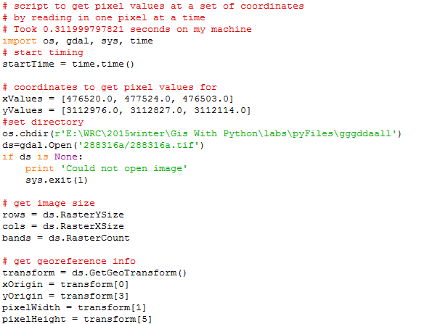

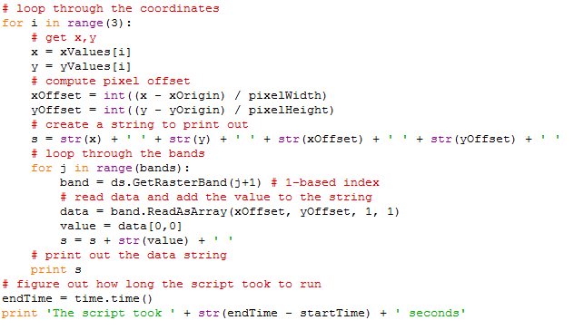
Example exercise
x y ofX ofY PxlVal

Slide 20
Example exercise
# script to get pixel values at a set of coordinates
# by reading in one pixel at a time
# Took 0.311999797821 seconds on my machine
import os, gdal, sys, time
# start timing
startTime = time.time()
# coordinates to get pixel values for
xValues = [476520.0, 477524.0, 476503.0]
yValues = [3112976.0, 3112827.0, 3112114.0]
#set directory
os.chdir(r'E:\WRC\gggddaall')
ds=gdal.Open('288316a/288316a.tif')
if ds is None:
print 'Could not open image'
sys.exit(1)
# get image size
rows = ds.RasterYSize
cols = ds.RasterXSize
bands = ds.RasterCount
# get georeference info
transform = ds.GetGeoTransform()
xOrigin = transform[0]
yOrigin = transform[3]
pixelWidth = transform[1]
pixelHeight = transform[5]
# loop through the coordinates
for i in range(3):
# get x,y
x = xValues[i]
y = yValues[i]
# compute pixel offset
xOffset = int((x - xOrigin) / pixelWidth)
yOffset = int((y - yOrigin) / pixelHeight)
# create a string to print out
s = str(x) + ' ' + str(y) + ' ' + str(xOffset) + ' ' + str(yOffset) + ' '
# loop through the bands
for j in range(bands):
band = ds.GetRasterBand(j+1) # 1-based index
# read data and add the value to the string
data = band.ReadAsArray(xOffset, yOffset, 1, 1)
value = data[0,0]
s = s + str(value) + ' '
# print out the data string
print s
# figure out how long the script took to run
endTime = time.time()
print 'The script took ' + str(endTime - startTime) + ' seconds'
x y ofX ofY PxlVal

Slide 21
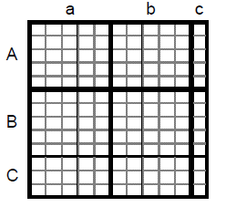
Reading block by block
The most efficient way to read data
Use one loop for the rows and one for the columns
Need to check that there is an entire block in both directions

Slide 22
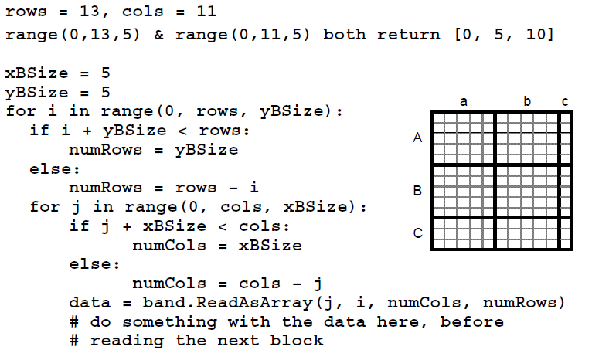
Reading block by block

Slide 23
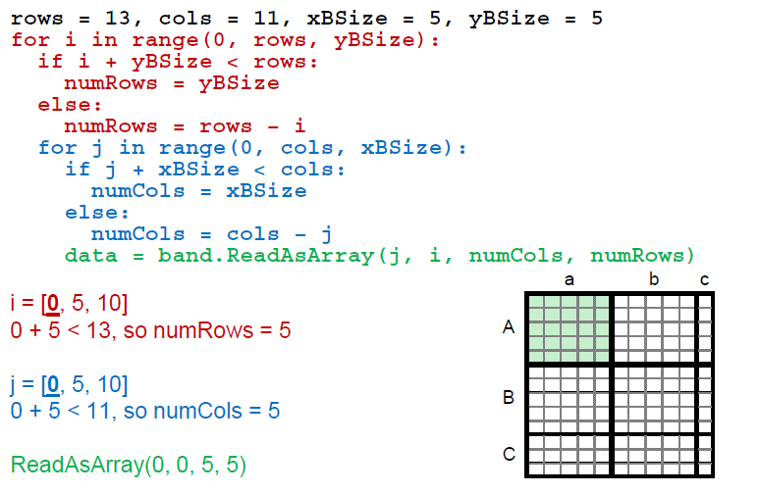
Reading block by block

Slide 24
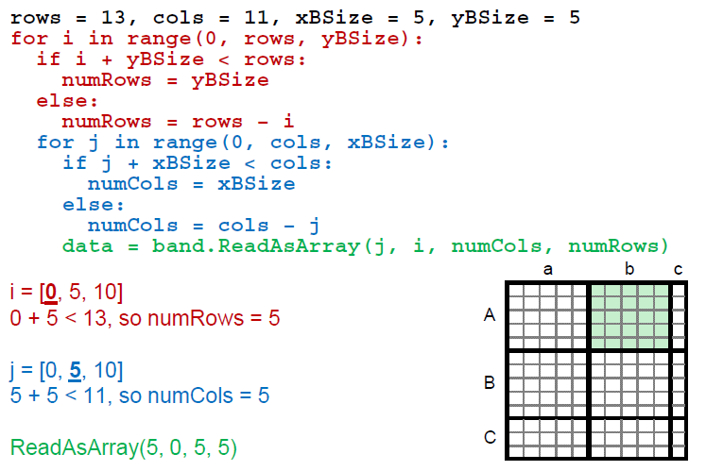
Reading block by block

Slide 25
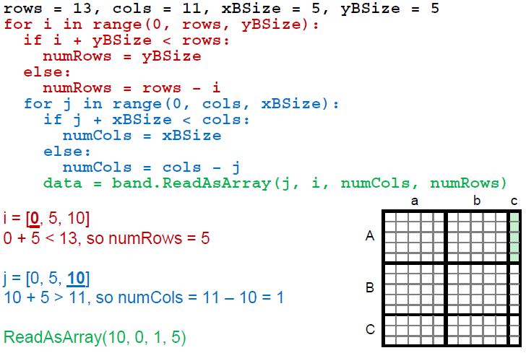
Reading block by block

Slide 26
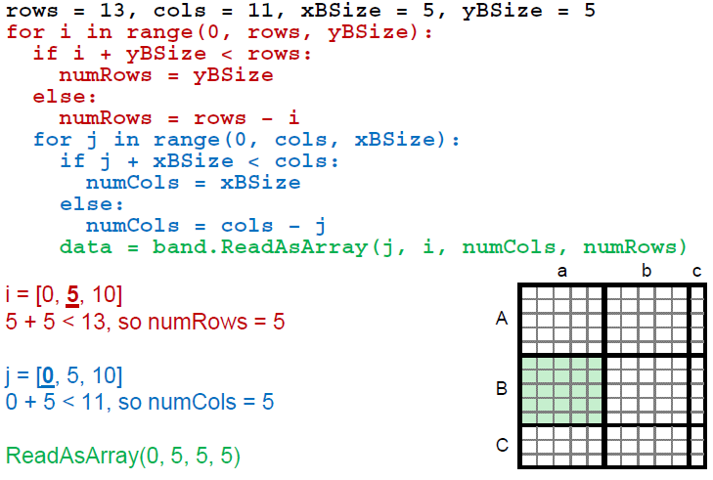
Reading block by block

Slide 27
Writing raster data
Need the appropriate driver
Fetch the driver using the GetDriverByName() method
The Create() method requires us to pass in the filename for the new image, the numbers of columns, rows and bands, and a constant specifying the data type
import gdal, osr, os
driver = gdal.GetDriverByName('GTiff')
outRaster = driver.Create(‘newRasterfn.tif’, cols, rows, 1, gdal.GDT_Float32)

Slide 28
Creating raster data
If we want to write our data to a same file type as source/input raster dataset can fetch the driver from source then create new raster file of the same type.
driver = inDataset.GetDriver()
outRaster = driver.Create(‘newRasterfn.tif’, cols, rows, 1, gdal.GDT_Float32)

Slide 29
Setting raster data
To georeference the new image
To set projection
outRaster.SetGeoTransform((originX, pixelWidth, 0, originY, 0, pixelHeight))
outRasterSRS = osr.SpatialReference()
outRasterSRS. spatialRef.ImportFromEPSG(26912)
outRaster.SetProjection(outRasterSRS.ExportToWkt())

Slide 30
Setting raster data
To georeference the new image as source dataset
To set projection as source dataset
outDataset.SetGeoTransform(inDataset.GetGeoTransform())
outDataset.SetProjection(inDataset.GetProjection())

Slide 31
Writing raster data
Then get the band object from output raster dataset and write array data into the band.
The first parameter is the array of data to write into the band, the second is the X offset to start writing at, and the third is the Y offset to start writing at
outBand = outDataset.GetRasterBand(1)
outBand.WriteArray(array, 0, 0)

Slide 32
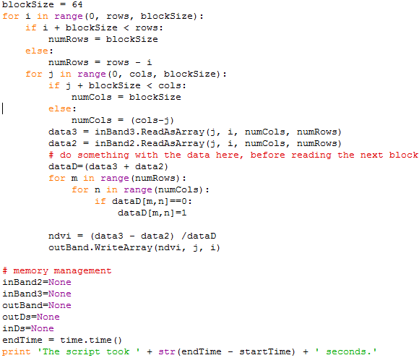
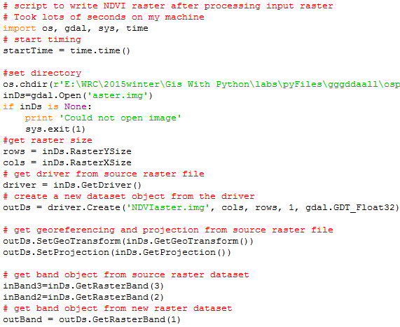
Writing raster data

Slide 33
Writing raster data
# script to write output raster after processing input raster
# Took lots of seconds on my machine
import os, gdal, sys, time
# start timing
startTime = time.time()
#set directory
os.chdir(r'E:\WRC\2015winter\Gis With Python')
inDs=gdal.Open('aster.img')
if inDs is None:
print 'Could not open image'
sys.exit(1)
#get raster size
rows = inDs.RasterYSize
cols = inDs.RasterXSize
# get driver from source raster file
driver = inDs.GetDriver()
# create a new dataset object from the driver
outDs = driver.Create('NDVIaster.img', cols, rows, 1, gdal.GDT_Float32)
# get georeferencing and projection from source raster file
outDs.SetGeoTransform(inDs.GetGeoTransform())
outDs.SetProjection(inDs.GetProjection())
# get band object from source raster dataset
inBand3=inDs.GetRasterBand(3)
inBand2=inDs.GetRasterBand(2)
# get band object from new raster dataset
outBand = outDs.GetRasterBand(1)
blockSize = 64
for i in range(0, rows, blockSize):
if i + blockSize < rows:
numRows = blockSize
else:
numRows = rows - i
for j in range(0, cols, blockSize):
if j + blockSize < cols:
numCols = blockSize
else:
numCols = (cols-j)
data3 = inBand3.ReadAsArray(j, i, numCols, numRows)
data2 = inBand2.ReadAsArray(j, i, numCols, numRows)
# do something with the data here, before reading the next block
dataD=(data3 + data2)
for m in range(numRows):
for n in range(numCols):
if dataD[m,n]==0:
dataD[m,n]=1
ndvi = (data3 - data2) /dataD
outBand.WriteArray(ndvi, j, i)

Slide 34
# memory management
inBand2=None
inBand3=None
outBand=None
outDs=None
inDs=None
endTime = time.time()
print 'The script took ' + str(endTime - startTime) + ' seconds.'
Image is read blockwise and written blockwise. Can read and write entire raster file. Check the time taken to process trying entire raster reading and writing.

